Slide 1
8 Battleship b = new Battleship(11,9);
9 Battleship b = Battleship.create(11,9);
10 Battleship.create(11,9);
11 Game g = Battleship.create(11,9);
12 Game g = GameCreator.create(11,9, GameType.Battleship);
13 Battleship g = new Battleship(new Rows(9), new Columns(11));
14 Battleship g = new Battleship(new Dimension(9,11));
15 int[] game = new int9;
16 var game = new Game({width: 9, height: 11});
17 var game = new Game{Width= 9, Height= 11};
18 var game = new Game(width= 9, height= 11);
19 var game = new Game(args);
20 var game = BattleShipLoader.load ( "...........\n" + "..CCCCC....\n" + "...........\n" + "....S......\n" + "....S......\n" + "....S......\n" + "...........\n" + "...........\n" + "...........\n" );
21 Battleship b = BattleshipBuilder.rows(11).columns(9).build();
22 Battleship b = BattleshipBuilder.rows(11).columns(9).build();
23 Battleship b = new Battleship(11,9,true,false,true, -5, "", null, null);
24 @Autowire Game game;
25 startBattleship();
26 var g = new Battleship(Level.Easy);
27 var g = new Battleship();
28 var g = new Battleship();
29 var g = new Chess();
Select * from GameSetup where name=“battleship” and width = 11 and height = 9
Select d.* from GameSetup gs, left join Details d on d.GameSetup = gs.pkey
where name=“battleship” and width = 11 and height = 9
var game = GameSetups.All.Where( g -> g.Name == “Battleship”).Cast<Battleship>().Where(g-> g.Width == 11).First(g -> g.Hieght == 9);

Slide 2
Micro API Design with Consume 1st

Slide 3

https://github.com/isidore/Talks/blob/master/EnglishToCode.md

Slide 4
The beauty of poetry is the same poem
can express a million different things to different people… … the beauty of code is different people can express
the same thing in a million different ways.”

Slide 5
// Create side (0,0) – (3,4)
// Verify length
Whiteboard
English
Testing Circle
Print Results
Code
Side (0,0) – (3,4) length = 5
Side s = new Side(0,0,3,4);
Approvals.Verify(s + “ length = “ +s.Length);

Slide 6
Battleship
0
1
2
3
4
5
6
7
8
9
10
0
1
// create a 11X9 Battleship game
2
// Place a sub at 4,3 heading south
3
// Place a carrier at 2,1 heading east
4
// Drop bomb at 2,3
7
// Drop bomb at 3,1
5
6
8

Slide 7
Battleship
0
1
2
3
4
5
6
7
8
9
10
0
1
// create a 11X9 Battleship game
2
3
4
7
5
6
8

Slide 8

Rules for Creating Code
Use your imagination
Write the code you want to exist, regardless of what currently does
array.isEmpty() ? null : array.get(0)
array.first()
Evaluate the consequences
Ask yourself “what are the resulting classes and methods from this implementation?”

Slide 9
LlewellynFalco
lfal.co/1commonsheet
Notes:
lfal.co/1commonsheet

Slide 10
Battleship b = new Battleship(11,9);
Battleship
Battleship(int, int)

Slide 11
Battleship b = Battleship.create(11,9);
Battleship
create(int, int)

Slide 12
Battleship.create(11,9);
Battleship
create(int, int)

Slide 13
Game g = Battleship.create(11,9);
Game
Battleship
create(int, int)

Slide 14
Game g = GameCreator.create(11,9, GameType.Battleship);
Game
GameType
Battleship
GameCreator
create(int, int, GameType)

Slide 15
Battleship g = new Battleship(new Rows(9), new Columns(11));
Battleship
Battleship(Rows, Columns)
Rows
Columns

Slide 16
Battleship g = new Battleship(new Dimension(9,11));
Battleship
Battleship(Dimension)
Dimension
Dimension(int, int)

Slide 17
int[] game = new int[9][11];
action(int[][])

Slide 18
var game = new Game({width: 9, height: 11});
Game
Game(HashMap)
Notes:
Needs documentation,
Semantic version can change without interface (eval)

Slide 19
var game = new Game{Width= 9, Height= 11};
Game
Game()
Width
Height
Notes:
Needs documentation,
Semantic version can change without interface (eval)

Slide 20
var game = new Game(width= 9, height= 11);
Game
Game(int width, int height)
Notes:
Needs documentation,
Semantic version can change without interface (eval)

Slide 21
var game = new Game(args);
Game
Game(GameArgs)
GameArgs
Width
Height
Other
Notes:
Needs documentation,
Semantic version can change without interface (eval)

Slide 22
var game = BattleShipLoader.load ( "...........\n" + "..CCCCC....\n" + "...........\n" + "....S......\n" + "....S......\n" + "....S......\n" + "...........\n" + "...........\n" + "...........\n" );
Battleship
BattleshipLoader
load(String)

Slide 23
var game = BattleShipLoader.read_csv(“battleshipboard.csv”);
Battleship
BattleshipLoader
read_csv(String)
Notes:
Needs documentation,
Semantic version can change without interface (eval)

Slide 24
Battleship b = BattleshipBuilder.rows(11).columns(9).build();
Battleship
BattleshipBuilder
rows(int)
columns(int)
build()
Notes:
Needs documentation,
Semantic version can change without interface (eval)

Slide 25
Battleship b = BattleshipBuilder.rows(11).columns(9).build();
Battleship
BattleshipBuilder
_Rows
_Columns
rows(int)
columns(int)
build()
Notes:
Needs documentation,
Semantic version can change without interface (eval)

Slide 26
Battleship b = Create.a(11,9).battleShipGame();
Create
BoardCreator
Battleship
a(int,int)
battleShipGame()
Notes:
Needs documentation,
Semantic version can change without interface (eval)

Slide 27
Battleship b = Create.a(11).by(9).battleShipGame();
Create
BoardCreator
Battleship
a(int)
by(int)
battleShipGame()
Notes:
Needs documentation,
Semantic version can change without interface (eval)

Slide 28
Battleship b = new Battleship(11,9,true,false,true, -5, "", null, null);
Battleship
Battleship(int, int, Boolean, Boolean, Boolean, int, string, ?, ?)

Slide 29
@Autowire Game game;
Game

Slide 30
startBattleship();
global_state
startBattleship()

Slide 31
var g = new Battleship(Level.Easy);
Battleship
Battleship(Level)
Level
Easy, Medium, Hard

Slide 32
var g = new Battleship();
Battleship
width = 11
Height = 9
Battleship()

Slide 33
var g = new Battleship();
Config
Battleship
Width:
Height:
Battleship()

Slide 34
var g = new Chess();
Chess
Chess()

Slide 35
var g = Battleship.createElevenByNineBoard();
Battleship
createBoard(int, int)
createElevenByNineBoard()

Slide 36
var g = new BattleshipElevenByNine();
Battleship
BattleshipElevenByNine

Slide 37
var creation_future = AWS::CLI.createBattleShipGame( AWS::BattleshipGame::GameParameters.new())
CreationFuture
CLI
createBattleShipGame(GameParameters)
GameParameters

Slide 38
https://github.com/isidore/Talks/blob/master/EnglishToCode.md

Slide 39
Thank you!
I am Llewellyn Falco
Please connect on twitter & LinkedIn @LlewellynFalco
LlewellynFalco.blogspot.com

Slide 40
Code
Battleship b = new Battleship(11,9);
Battleship b = Battleship.create(11,9);
Game g = Battleship.create(11,9);
Battleship g = new Battleship(new Rows(9), new Columns(11));
Battleship g = new Battleship(new Dimension(9,11));
int[] game = new int[9][11];
var game = new Game({width: 9, height: 11});
var game = new Battleship(args);
var game = BattleShipLoader.load(
"...........\n" +
"..CCCCC....\n" +
"...........\n" +
"....S......\n" +
"....S......\n" +
"....S......\n" +
"...........\n" +
"...........\n" +
"...........\n"
);
Battleship b = BattleshipBuilder.rows(11).columns(9).build();
Battleship b = new Battleship(11,9,true, -5, "", null, null);
@Autowire
Game game;
var g = new Game(Level.Easy);
startBattleship();

Slide 41
Battleship
White
Gray
Black

Slide 42
Instructions for use
EDIT IN GOOGLE SLIDES
Click on the button under the presentation preview that says "Use as Google Slides Theme".
You will get a copy of this document on your Google Drive and will be able to edit, add or delete slides.
You have to be signed in to your Google account.
EDIT IN POWERPOINT®
Click on the button under the presentation preview that says "Download as PowerPoint template". You will get a .pptx file that you can edit in PowerPoint.
Remember to download and install the fonts used in this presentation (you’ll find the links to the font files needed in the Presentation design slide)
More info on how to use this template at www.slidescarnival.com/help-use-presentation-template
This template is free to use under Creative Commons Attribution license. You can keep the Credits slide or mention SlidesCarnival and other resources used in a slide footer.

Slide 43

hello!
I am Jayden Smith
I am here because I love to give presentations.
You can find me at @username

Slide 44
Quotations are commonly printed as a means of inspiration and to invoke philosophical thoughts from the reader.

Slide 45
This is a slide title
Here you have a list of items
And some text
But remember not to overload your slides with content
Your audience will listen to you or read the content, but won’t do both.

Slide 46
Big concept
Bring the attention of your audience over a key concept using icons or illustrations

Slide 47
You can also split your content
White
Is the color of milk and fresh snow, the color produced by the combination of all the colors of the visible spectrum.
Black
Is the color of coal, ebony, and of outer space. It is the darkest color, the result of the absence of or complete absorption of light.

Slide 48
In two or three columns
Yellow
Is the color of gold, butter and ripe lemons. In the spectrum of visible light, yellow is found between green and orange.
Blue
Is the colour of the clear sky and the deep sea. It is located between violet and green on the optical spectrum.
Red
Is the color of blood, and because of this it has historically been associated with sacrifice, danger and courage.

Slide 49
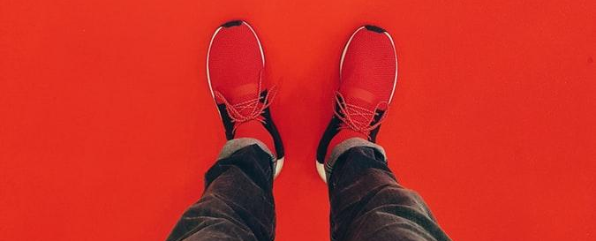
A picture is worth a thousand words
A complex idea can be conveyed with just a single still image, namely making it possible to absorb large amounts of data quickly.

Slide 50
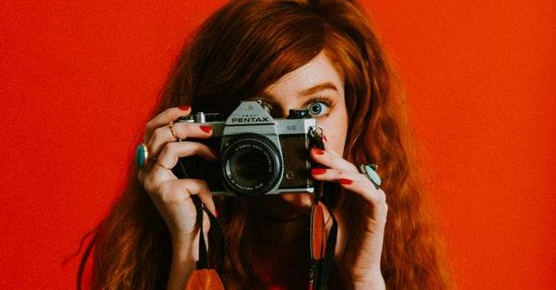
Want big impact?
Use big image.

Slide 51
And tables to compare data
 | A | B | C
Yellow | 10 | 20 | 7
Blue | 30 | 15 | 10
Orange | 5 | 24 | 16

Slide 52
Maps
our office

Slide 53
89,526,124
Whoa! That’s a big number, aren’t you proud?

Slide 54
89,526,124$
185,244 users
100%
That’s a lot of money
And a lot of users
Total success!

Slide 55
Our process is easy
first
second
last

Slide 56
Let’s review some concepts
Yellow
Is the color of gold, butter and ripe lemons. In the spectrum of visible light, yellow is found between green and orange.
Blue
Is the colour of the clear sky and the deep sea. It is located between violet and green on the optical spectrum.
Red
Is the color of blood, and because of this it has historically been associated with sacrifice, danger and courage.
Yellow
Is the color of gold, butter and ripe lemons. In the spectrum of visible light, yellow is found between green and orange.
Blue
Is the colour of the clear sky and the deep sea. It is located between violet and green on the optical spectrum.
Red
Is the color of blood, and because of this it has historically been associated with sacrifice, danger and courage.

Slide 57
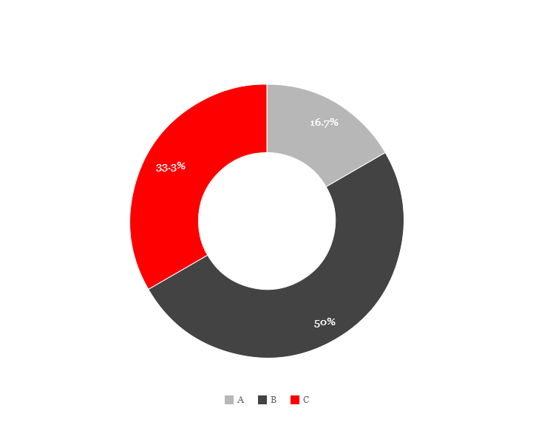
You can copy&paste graphs from Google Sheets

Slide 58
Mobile project
Place your screenshot here
Show and explain your web, app or software projects using these gadget templates.

Slide 59
Tablet project
Place your screenshot here
Show and explain your web, app or software projects using these gadget templates.

Slide 60
Desktop project
Place your screenshot here
Show and explain your web, app or software projects using these gadget templates.

Slide 61
thanks!
Any questions?
You can find me at
@username
user@mail.me
?

Slide 62
Credits
Special thanks to all the people who made and released these awesome resources for free:
Presentation template by SlidesCarnival
Photographs by Unsplash

Slide 63
Presentation design
This presentations uses the following typographies and colors:
Titles: Roboto Slab
Body copy: Georgia (system font)
You can download the font on this page:
https://www.fontsquirrel.com/fonts/roboto-slab
Dark gray #111111
Light gray #999999
Red #ff0000
You don’t need to keep this slide in your presentation. It’s only here to serve you as a design guide if you need to create new slides or download the fonts to edit the presentation in PowerPoint®

Slide 64
SlidesCarnival icons are editable shapes.
This means that you can:
Resize them without losing quality.
Change line color, width and style.
Isn’t that nice? :)
Examples:

Slide 65
😉
Now you can use any emoji as an icon!
And of course it resizes without losing quality and you can change the color.
How? Follow Google instructions https://twitter.com/googledocs/status/730087240156643328
✋👆👉👍👤👦👧👨👩👪💃🏃💑❤😂😉😋😒😭👶😸🐟🍒🍔💣📌📖🔨🎃🎈🎨🏈🏰🌏🔌🔑 and many more...

Slide 66

Free templates for all your presentation needs
For PowerPoint and Google Slides
100% free for personal or commercial use
Ready to use, professional and customizable
Blow your audience away with attractive visuals

